Slide 1
APPLICATIONS OF GENETIC ALGORITHM

Slide 2
Key Features Of GA// defination
GAs work with a coding of the parameter set and not the parameter themselves.
GAs search from a population of points and not from a single point and move parallel.
GAs use objective function information and not derivatives or other auxiliary knowledge.
GAs are probabilistic transition rules and not deterministic rules and uses random stochastic nature.

Slide 3
Methodology

Slide 4
Initial Generation
Selection
Crossover
Next Generation
Mutation
Fitness

Slide 5
Let us consider an example in which we need to find the optimum solution of F(X₁,X₂) .
F(X₁,X₂) = X₁² – X₂² – 5.13
The unknown parameters are X₁ and X_{2.}
Solution Space of X₁ and X₂ Є [ 0, 15 ]

Slide 6
Initial Generation
Selection
Crossover
Next Generation
Mutation
Fitness

Slide 7
Initial Population
X₁ X₂
1 0 0 1
1 1 0 1
1 0 0 1 1 1 0 1
1 Complete Population

Slide 8
Initial Generation
1 1 0 1 1 0 1 0
0 1 1 1 1 0 1 1
1 1 1 0 1 0 1 0
0 0 0 1 1 0 1 0
0 0 1 1 0 0 0 1
1 1 0 1 1 0 0 0
1 0 1 0 1 0 1 1
1 1 1 0 0 0 1 0
1 0 1 0 0 0 1 0
0 1 1 1 1 0 1 1

Slide 9
Initial Generation
Selection
Crossover
Next Generation
Mutation
Fitness

Slide 10
Fitness Function
Fitness Function is an Objective Function which we need to maximize .
In our example we have considered
Fitness Function = 1/abs(X₁² – X₂² – 5.13)

Slide 11
While Choosing An Appropriate Fitness Function
define Fitness Function in such a way so that it increases even with searching for minima or maxima.

Slide 12
In the above string X1 is 9 and X2 is 13.
Therefore, the value of Fitness Function is 0.011.
In this way, the fitness values of all the populations are calculated .
1 0 0 1 1 1 0 1

Slide 13
Initial Generation
Selection
Crossover
Next Generation
Mutation
Fitness

Slide 14
Selection
The selection function choses parent for the next generation based on their scaled values from the fitness scaling function.
There are several methods for Selection but we have considered here Roulette Wheel Selection Scheme.

Slide 15
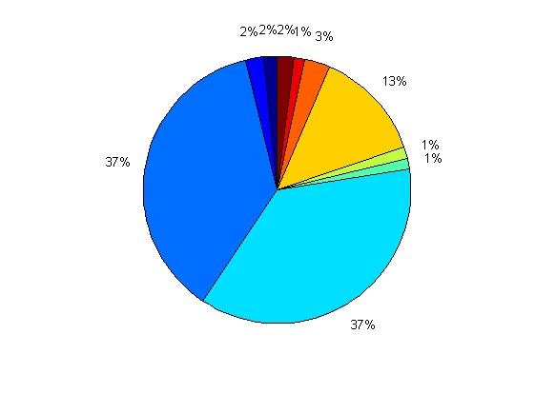
Roulette Selection

Slide 16
We can see that some of the strings are repeated which have greater fitness values.
Before Selection
1 1 0 1 1 0 1 0
0 1 1 1 1 0 1 1
1 1 1 0 1 0 1 0
0 0 0 1 1 0 1 0
0 0 1 1 0 0 0 1
1 1 0 1 1 0 0 0
1 0 1 0 1 0 1 1
1 1 1 0 0 0 1 0
1 0 1 0 0 0 1 0
0 1 1 1 1 0 1 1
After Selection
1 1 1 0 1 0 1 0
0 0 1 1 0 0 0 1
0 0 1 1 0 0 0 1
0 0 1 1 0 0 0 1
0 0 1 1 0 0 0 1
1 1 0 1 1 0 0 0
0 0 1 1 0 0 0 1
0 0 1 1 0 0 0 1
1 1 0 1 1 0 0 0
1 1 1 0 1 0 1 0

Slide 17
Initial Generation
Selection
Crossover
Next Generation
Mutation
Fitness

Slide 18
Before Crossover
1 1 1 0 1 0 1 0
0 0 1 1 0 0 0 1
After Crossover
1 1 1 1 0 0 0 1
0 0 1 0 1 0 1 0

Slide 19
Modified Generation
0 0 1 1 0 0 0 1
0 0 1 1 0 0 0 1
1 1 1 1 0 0 0 1
0 0 1 0 1 0 1 0
0 0 1 1 0 0 0 1
0 0 1 1 0 0 0 1
0 0 0 1 1 0 0 0
1 1 1 1 0 0 0 1
1 1 1 0 1 0 1 0
1 1 0 1 1 0 0 0

Slide 20
Initial Generation
Selection
Crossover
Next Generation
Mutation
Fitness

Slide 21
Mutation
0 0 1 1 0 0 0 1
0 0 0 1 0 0 0 1
Mutation make small random changes in the individuals in the population which provide genetic diversity and enables the GA to search a broader space.

Slide 22
Initial Generation
Selection
Crossover
Next Generation
Mutation
Fitness

Slide 23
Next Generation
0 0 1 1 0 0 0 1
0 0 1 1 0 0 0 1
1 1 1 1 0 0 0 1
0 0 1 0 1 0 1 0
0 0 1 1 0 0 0 1
0 0 1 1 0 0 0 1
0 0 0 1 1 0 0 0
1 1 1 1 0 0 0 1
1 1 1 0 1 0 1 0
1 1 0 1 1 0 0 0

Slide 24
MAIN PROBLEM STATEMENT

Slide 25
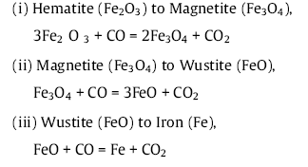
The problem which we have chosen shows an application of Genetic Algorithm (GA) to estimate the rate parameters for solid state reduction of iron ore in presence of graphite.
The iron ore undergoes reduction in three following steps:

Slide 26
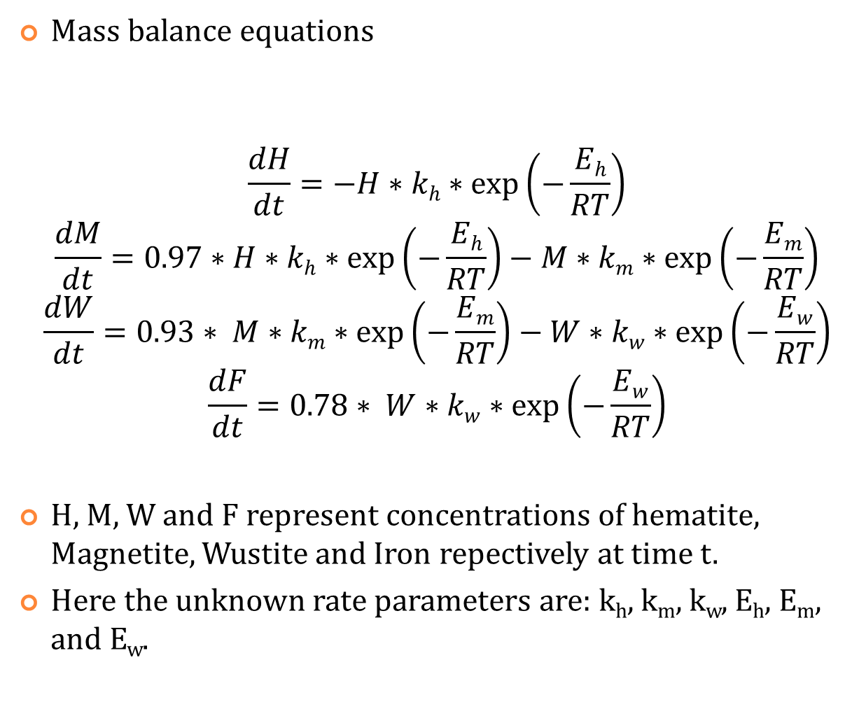
Mass balance equations
$$\frac{dH}{dt}=−H∗kh∗\exp\left(−\frac{Eh}{RT}\right)$$
$$\frac{dM}{dt}=0.97∗H∗kh∗\exp\left(−\frac{Eh}{RT}\right)−M∗km∗\exp\left(−\frac{Em}{RT}\right)$$
$$\frac{dW}{dt}=0.93∗ M∗km∗\exp\left(−\frac{Em}{RT}\right)−W∗kw∗\exp\left(−\frac{Ew}{RT}\right)$$
$$\frac{dF}{dt}=0.78∗ W∗kw∗\exp\left(−\frac{Ew}{RT}\right)$$
H, M, W and F represent concentrations of hematite, Magnetite, Wustite and Iron repectively at time t.
Here the unknown rate parameters are: k_{h}, k_{m}, k_{w}, E_{h}, E_{m}, and E_{w}.

Slide 27
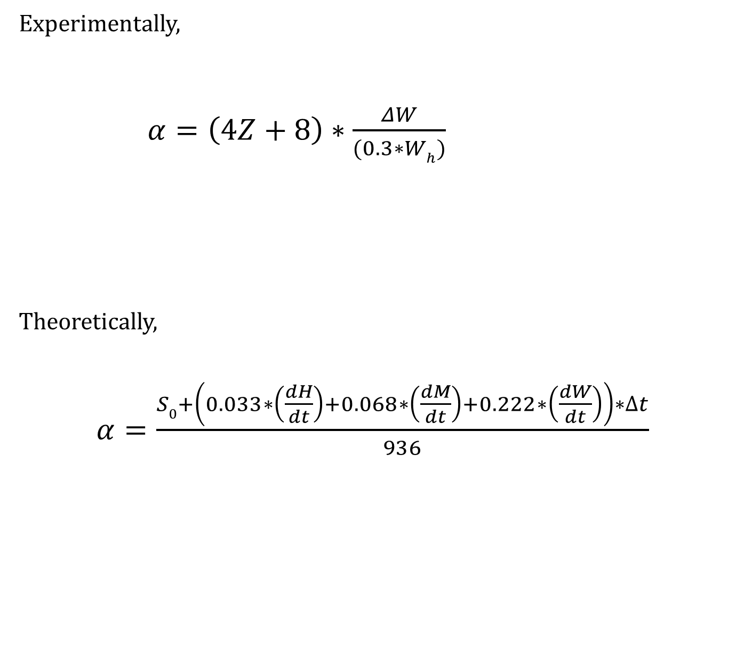
Experimentally,
$α=\left(4Z+8\right)∗\frac{ΔW}{(0.3∗Wh)}$
Theoretically,
$α=\frac{S0+\left(0.033∗\left(\frac{dH}{dt}\right)+0.068∗\left(\frac{dM}{dt}\right)+0.222∗\left(\frac{dW}{dt}\right)\right)∗∆t}{936}$
Loss in weight of Packed Bed
Degree of Reduction
CO/CO₂ for exit gas
Total weight of Hematite at time t
Oxygen consumed in 𝝙t

Slide 28

FITNESS FUNCTION
In this problem we define fitness function as
$$\frac{1}{(αExperimental −αTheoretical)}$$

Slide 29
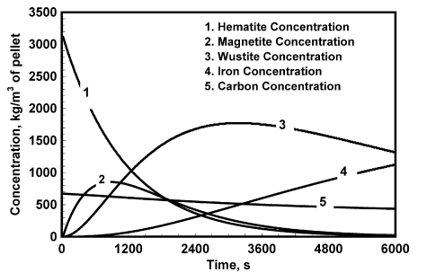
Evaluation of concentration of various iron oxide phases as well as
Pure iron during packed bed reduction of iron ore – graphite composite
Pellets under argon atmosphere at 1000⁰C

Slide 30
GA code is written and run using MATLAB and the options used are:
Generations | 400
Mutation Probability | 0.01
Cross over probability | 0.8
Selection technique | Tournament selection

Slide 31
Results and Discussion
 | Kh (s⁻¹) | Km (s⁻¹) | Kw (s⁻¹) | Eh (KJ/mol) | Em (KJ/mol) | Ew (KJ/mol)
GA | 3.944*10^17 | 9.705*10^16 | 3.973*10^11 | 188.1611 | 393.6013 | 321.0304
literature | 6.00*10^17 | 7.50*10^16 | 1.70*10^11 | 380 | 410 | 330
Sources of errors in our calculation are:
The mutation probabilities are not the same as used in the paper.
The conditions mentioned in the problem is slightly varied like the elitism is not considered, the range is not the same as in the paper, etc.

Slide 32
Strengths of GA
Applicable in problems where no good method is available
Discontinuities, non-linear constraints
Discrete variable space
Intrinsically defined models(if-then-else)
Noisy problems
Multiple solutions exists
Multi model optimization problems
Multi-objective optimization problems
Parallel implementation is easier

Slide 33
Major Problems While Using GA
Difficulty in population selection
How to define Fitness Function
Premature or rapid convergence of GA
Converge to local optima instead of global optima
How we can overcome them????

Slide 34
Population Selection
2^{m-1}< (b-a)*decimal order accuracy < 2^{m}
Lower limit
Upper limit
No. of bits

Slide 35
Rapid convergence of GA
Fitness values may converge very rapidly.
F’ = a*F + b ;
F is normal Fitness value of the population String.
F’ = a*F^{k} , this is called power law
Advanced way to define Fitness function in which Fitness Function is
modified in each and every generation. So,
k = func(t)
a is very small and b is a larger value
K is very small
Here t is generation

Slide 36
Convergence to Local Optima
GA’s ability to find the optimal solution lies in the hand of the
user.
Optimal solution will be achieved only if GA has the ability to
search over whole space to find the optimal solution.
In such case, crossover and mutation functions should be
modified as they are responsible for changing the population
in each and every iteration.

Slide 37
GA: Why do they work ??
How can we be sure that the next generation is reching closer to the
optimum solution?
We will show how GA refines the solution space to reach the optimum
solution by mathematical model.

Slide 38
Schema is defined as
*10101100101
Where * is called as don’t care symbol and can be either 1 or 0
So the above schema matches with the strings shown below:
110101100101
010101100101

Slide 39
Two important schema properties that should be noted here:
Order of the Schema (denoted by o(S))
Defining length of Schema(denoted by Ω(S))
Example –
S1 = ***001*110
S2 = 11101**001
So
o(S1) = 6, o(S2) = 8 ;
Ω(S1) = 10-4 = 6, Ω(S2) = 10-1 = 9

Slide 40
£(S,t) : The number of string in the population which matches with the Schema at time t.
E.g.,
S = ****111***********************
If this is the population
X1 = 11110111000000101010101010100
X2 = 01111111001010010101001010101
X3 = 01010100101011111111111111000
X4 = 00000011111111111100000000011
X5 = 10110110000000011010101001101
X6 = 10101111110100000000111111111
X7 = 00000000011111111101101010010
X8 = 01011111111000000000111111111
X9 = 10101010010100000111111111000
X10 = 10101010100100101001010010101
So £(S,t) = 3

Slide 41
eval (S,t) is defined as the average fitness of the String in the population which matches with the Schema ,i.e
eval(S,t) = ∑_{i=1}^{P} eval(Xi)/P
The expected number of String which will match with the Schema after the Selection is given by the relation below:
£(S,t+1) = (£(S,t))*(eval(S,t) /F(S,t))
Where F(S,t) is the average fitness of the entire population
F(S,t)/pop_size
pop_size is the population size

Slide 42
Now from the above relation it is clear that “above average ” Schema receive an increasing number of String in the next generation and “below average” Schema receive decreasing number of String in the next generation
Now if we assume that Schema S remain above average that means
eval(S,t) = F(S,t) + α.F(S,t)
So after t Selections
£ (S,t) = £(S,0)(1 + α)^{t}

Slide 43
Now we will consider the effect of Crossover and Mutation
S1 = ***111**************************
S2 = 111***************************01
Probability of survival of single String after Crossover is
p_{s}(S) = 1 - p_{c}(S). Ω(S)/(m-1)
p_{c}(S) is the Crossover probability,
For p_{c}(S) = 1,
p_{s}(S1) = 30/32 , p_{s}(S2) = 0
In fact
p_{s}(S) ≥ 1 - p_{c}(S). Ω(S)/(m-1)

Slide 44
The expected number of String which will match in the next iteration with the
Schema is given by the relation below:
£(S,t+1) = (£(S,t) .eval(S,t) /F(S,t)).[ 1 - p_{c}(S). Ω(S)/(m-1)]

Slide 45
Consider Mutation
Since the probability of alteration of single bit is p_{m} the probability of survival of bit is 1- p_{m} . So
p_{s}(S) = (1 – p_{m})^{o(S)}
since p_{m} << 1 . So
p_{s}(S) ̴ 1 –o(S).P_{m}
Hence,
£(S,t+1) = (£(S,t) .eval(S,t) /F(S,t)).[ 1 - p_{c}(S). Ω(S)/(m-1) - o(S). p_{m}]

Slide 46
£(S,t+1) = £(S,0) .[eval(S,t) /F(S,t).[ 1 - p_{c}(S). Ω(S)/(m-1) - o(S). p_{m}]]^{t}
So this is the final expected number of String which will be same as that of Schema.
If [eval(S,t) /F(S,t).[ 1 - p_{c}(S). Ω(S)/(m-1) - o(S). p_{m}]] > 1
then the number of String similar to Schema will increase exponentially otherwise decrease exponentially.
So this is how GA discriminate between the above average Schema and below average Schema and refine the space to reach to the optimums solution

Slide 47
Conclusion
Studying the GA as an optimizing technique with its advantages over other optimizing technique and its limitations.
One generation of GA is shown explaining its mechanism and proving that with each generation we reach closer to the optimum solution.
Application of GA is studied in Chemical Engineering to estimate the rate parameters.
GA has implicit technique which ensures that with each generation, we get closer to the optimum solution.

Slide 48
References
Golap Md. Chowdhury, Gour G. Roy, “Application of Genetic Algorithm (GA) to estimate the rate parameters for solid state reduction of iron ore in presence of graphite”, Computational Materials Science 45 (2009) 176–180.
Dorit Wolf and Ralf Moros, “Estimating Rate Constant of Heterogeneous Catalytic Reaction without supposition of Rate Determining surface step-An Application of Genetic Algorithm”, Chemical Engineering Science, Vol. 52, No. 7, pp. 1189-1199, 1997.
David E. Goldberg, “Genetic Algorithms in search, optimization and machine learning”
Adam Marczyk, “Genetic Algorithms and Evolutionary Computation”
www.rennard.org/alife/english/gavintrgb.html
www.ai-junkie.com/ga/intro/gat1.html
www.genetic-programming.org/
en.wikipedia.org/wiki/Genetic algorithm

Slide 49


